Slide 1
Software Development Life Cycle
Presented by:- Prajwol, Roshan, Prasant

Slide 2
What is SDLC?
Is also known as SDLC or software development process
framework defining steps done while developing any software
ISO/IEC 12207 is an international standard defining essentials of building and maintaing software

Slide 3
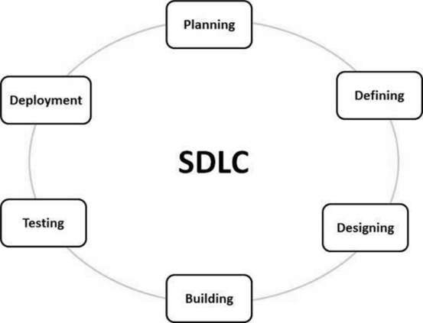
Phases of SDLC

Slide 4
Planning
Study every possible options
Financial
Requirement
Technical
Why should we plan?
To keep the project on track
To evaluate the progress

Slide 5
Defining
Identification of the problems
Breaking down the problem
Analyzing the situation
Collecting possible solutions
Through surveys, questionnaire
Through data, statistics
Preparing documents after analyzing

Slide 6
Designing
Identifying if the software will be outsourced or built in house
Identifying the end users
Developing a user friendly site
Site geared towards its users
Reexamine the feasibility study done in Analysis phase

Slide 7
Building
Following the analysis phase of the build
Coders and designers working in the project
A strong team created to complete the task in given time

Slide 8
Testing
Analyst testing the product
Problems are discovered and debugged
Check whether the software is reliable, fast and responsive

Slide 9
Deployment
Sending the product to the client
Solve any problem if required
Finalize the product in the market

